Slide 1
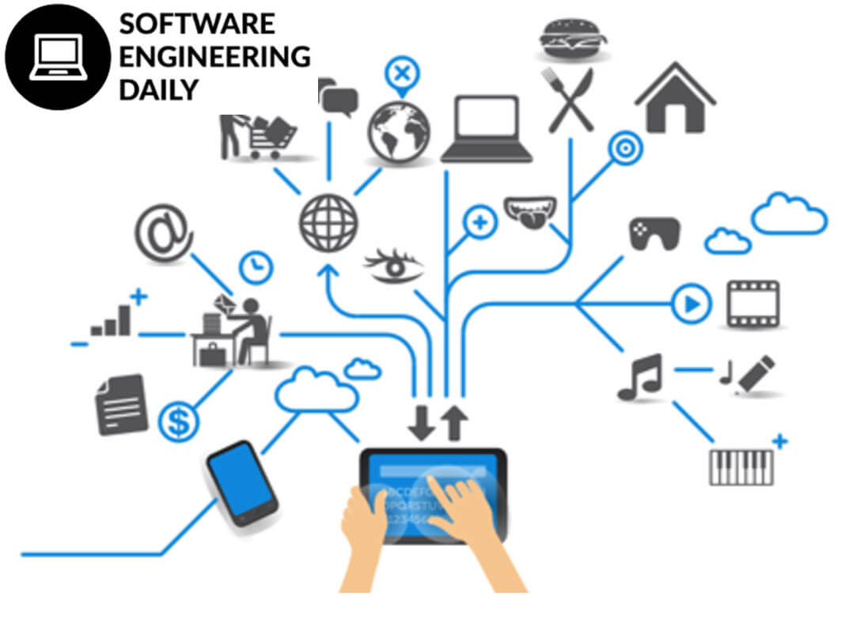
PART-II
Software Engineering (SE) → CSEN3202 – CSE/BTech/6th Semester → Module-I → Prepared by : Nilina Bera, CSE, HITK

Slide 2
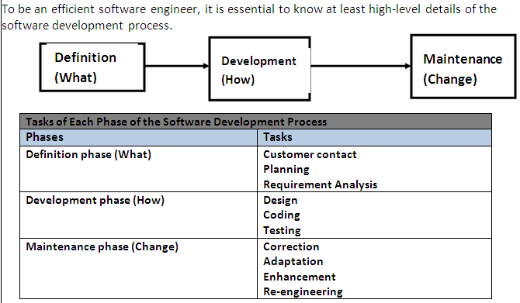
Standard Observation of Software Engineering
Nilina Bera

Slide 3
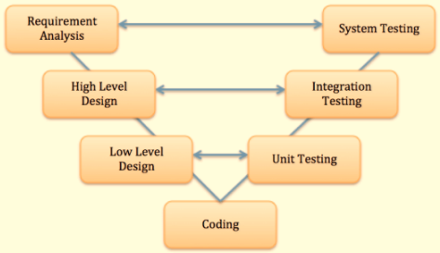
Software Lifecycle models
The left side of the model is Software Development Life Cycle - SDLC
The right side of the model is Software Test Life Cycle - STLC
The entire figure looks like a V, hence the name V – model
A life cycle model prescribes the different activities that need to be carried out to develop a software product and the sequencing of these activities…
A software or system development life cycle is a series of identifiable stages that a software product undergoes during its lifetime.
A software life cycle model is a descriptive representation of the software from its inception to delivery to maintenance…
Nilina Bera

Slide 4
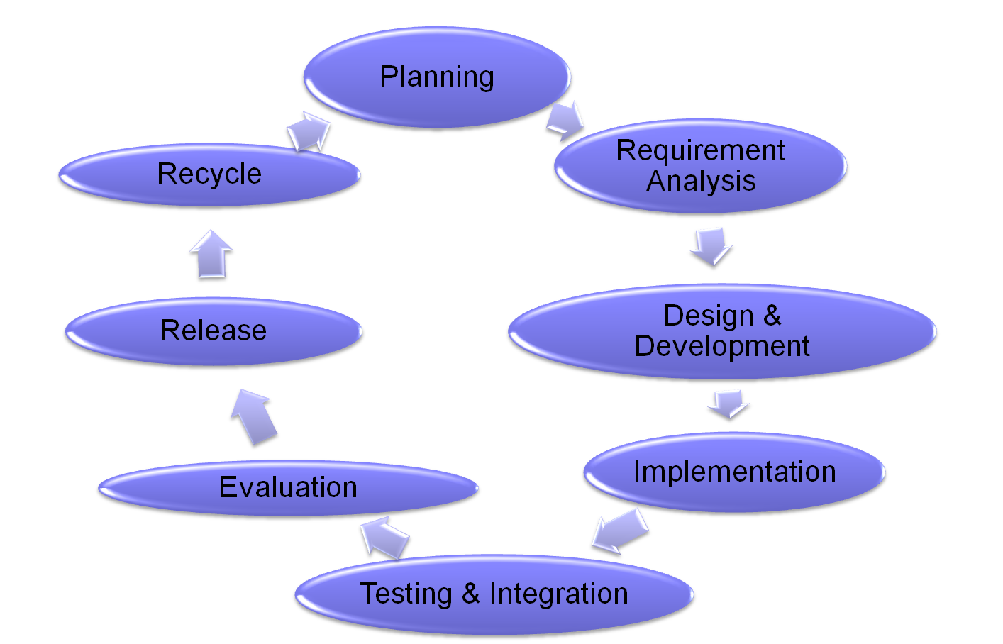
Software Development Life Cycle (SDLC)
Nilina Bera

Slide 5
SDLC….
Phase 1 : Planning : Planning is the first phase of software development. In this phase the clients give the details and concepts of his/her software and we plan the requirement of resources, time & budget of the proposed development.
Phase 2 - Requirements Analysis : The requirements analysis phase is concerned with capturing the requirements of the package. The requirements review is a meeting with the aim of discussing these requirements. The final output of this phase is a formal requirements document (Software Requirement Specification), which aims to freeze the requirements at this point and will serve as input to the design phase.
Nilina Bera

Slide 6
SDLC….
Phase 3 - Design : The design phase is concerned with design of the software. Things to keep in mind are things like quality, flexibility (code reuse, future addition of features/functionality) etc. The final output of this phase is a formal design document (Software Design Document), which aims to freeze the design at this point and will serve as input to the coding phase. It serves as secondary function as a reference document for the code and can be particularly useful for developers that should work on the code in the future.
Phase 4 – Development (Implementation) : The implementation phase involves the actual coding/programming of the software.
The output of this phase is typically the Library, Executables and User Manuals and additional software documentation.
Nilina Bera

Slide 7
SDLC…
Phase 5 - Testing and Integration : The testing phase is concerned with the validation and verification of the software Unit testing is done on units and integration testing is done by including this package/unit together with other packages/units and testing them all together.
Phase 6 – Evaluation : Release the pilot of the product and client evaluates the product. If he /she require modification in the product he suggests it and we do it within a very short span of time.
Phase 7 – Release : The Release phase involves the packaging of all sub-packages, together with all relevant documentation in a suitable format for distribution.
Phase 8 – Recycle: In case of long term projects, the release phase is the starting point of recycling of the project, but in short term projects release phase is the point of sign off too.
Nilina Bera

Slide 8
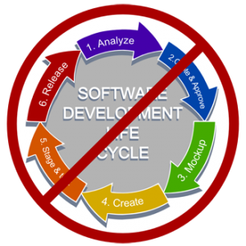
SOFTWARE LIFE CYCLE MODELS
ONE OF THE LIFE CYCLE MODEL POPULARLY KNOWN AS SUCCESSIVE VERSIONS MODEL IS CREATED TO “DESIGN A LITTLE”, “BUILD A LITTLE”, “TEST A LITTLE”, “DEPLOY A LITTLE MODEL”.
Nilina Bera

Slide 9
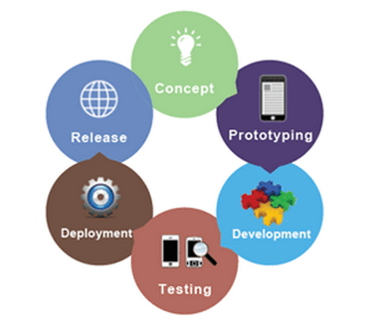
SOFTWARE PROCESS, PROJECT && PRODUCT
Software Engineering comprises interrelated and recurring entities, which are essential for software development. Software is developed efficiently and effectively with the help of well-defined activities or processes.
Nilina Bera

Slide 10
SOFTWARE PROCESS
Process is a series of steps involving activities and resources, which produces the desired output.
Software process is defined as a collection of procedures to develop the software product according to certain goals or standards.
A process uses resources subject to given constraints and produce intermediate and final products.
A process is composed of sub processes that are organized in such a manner that each sub process has its own process model.
A process is carried out with an entry and exit criteria that helps in monitoring the beginning and completion of the activity.
A process includes guidelines that explain the objectives of each activity.
A process is vital because it imposes uniformity on the set of activities.
A process is regarded as more than just a procedure, tools or techniques, which are collectively used in a structured manner to produce a product.
A process includes various technical and managerial issues, which are required to develop the software.
Nilina Bera

Slide 11
SOFTWARE PROJECT (1 Project – to – n projects)
A project is defined as a specification essential for developing or maintaining a specific product.
The activities in software project comprise various tasks for managing resources and developing products.
Software project involves people also referred to as participants who use software processes to create a product according to the user’s requirements.
A project is efficient if developed within the time constraint.
The outcome or the result of the software project is known as a product.
One Software Process can include n # of Software Projects that in turn can consist of m # of Software Products.
Nilina Bera

Slide 12
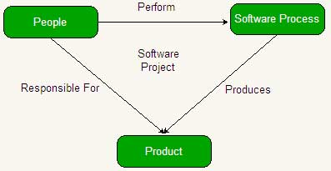
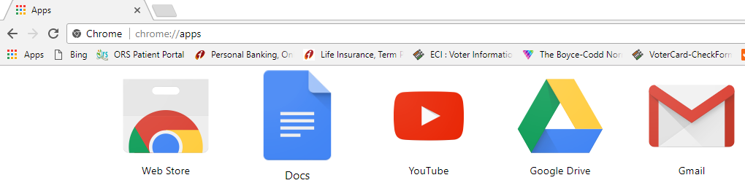
Nilina Bera

Slide 13
PROCESS ASSESSMENT
ISO (International Organization for Standardization) established a standard known as ISO 9001:2000 to determine the requirements of quality management systems.
A quality management system refers to the activities within an organization, which satisfies the quality related expectations of customers.
Organizations ensure that they have a quality management system by demonstrating their conformance to the ISO 9001:2000 standard. This standard follows a plan-do-check-act (PDCA) cycle that includes a set of activities as follows:
Nilina Bera

Slide 14
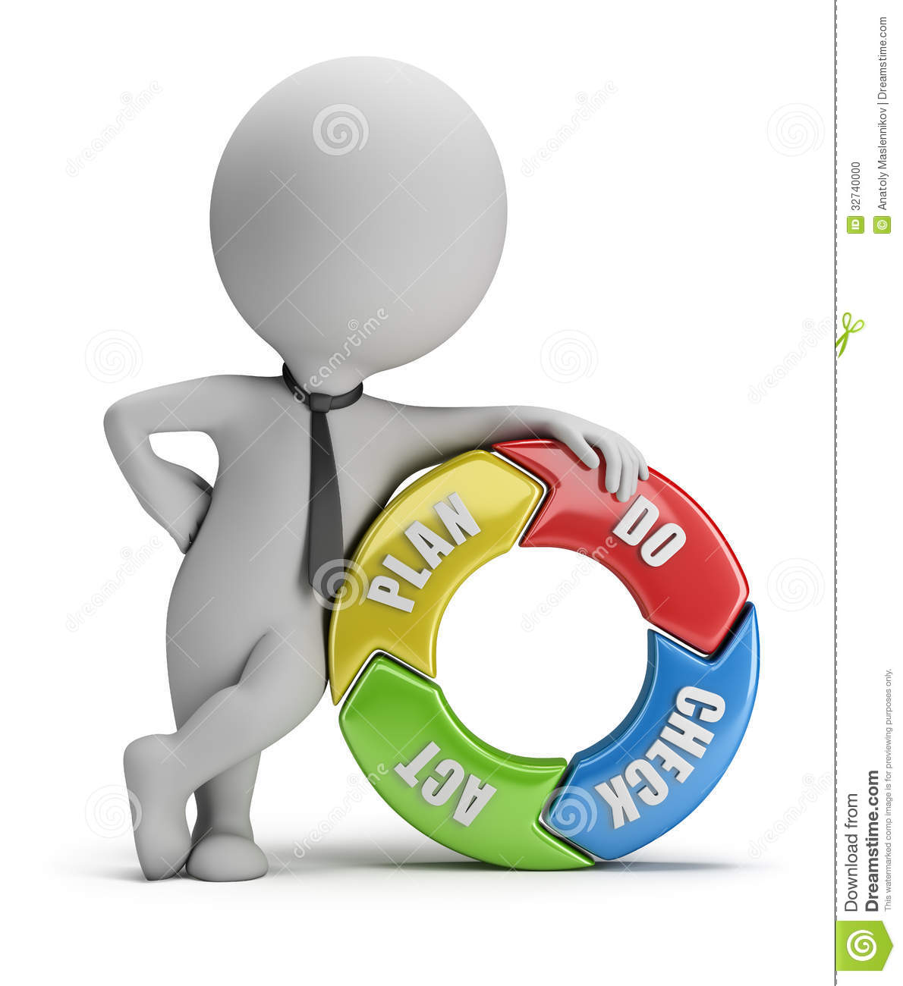
PLAN – DO – CHECK – ACT
Nilina Bera

Slide 15
PLAN – DO – CHECK – ACT
Plan: Determines the processes and resources which are required to develop a quality product according to the user’s satisfaction.
Do: Performs activities according to the plan to create the desired product.
Check: Measures whether the activities for establishing quality management according to the requirements are accomplished. In addition, it monitors the processes and takes corrective actions to improve them.
Act: Initiates activities which constantly improve processes in the organization.
Nilina Bera

Slide 16
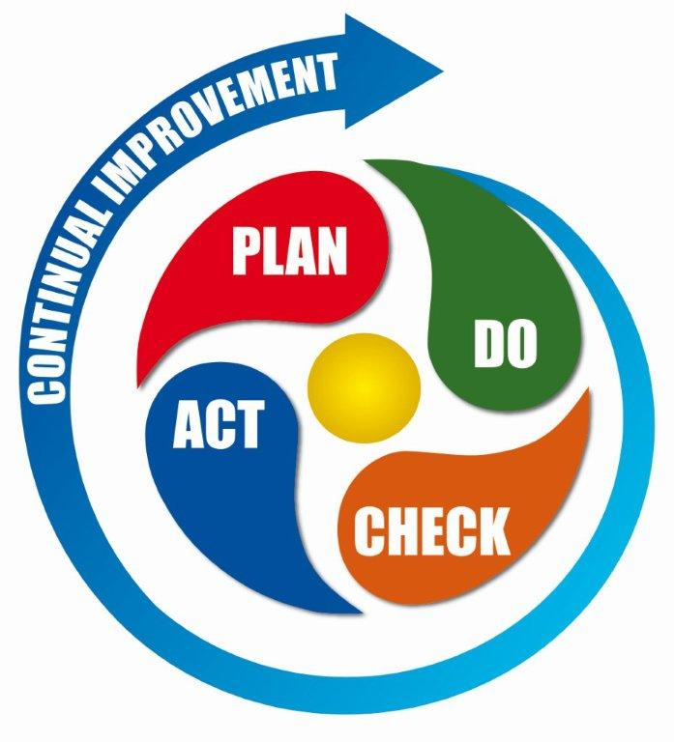
PLAN – DO – CHECK – ACT ….
Nilina Bera

Slide 17
Let’s refresh our mind →
1. What is meant by a dedicated computer?
[A] Which is used by one person only
[B] Which is assigned one and only one task
[C] Which uses one kind of software
[D] Which is meant for application software
B. Which is assigned one and only one task
2. The name for the way that computers manipulate data into information is called:
[A] programming
[B] processing
[C] organizing
[D] storing
Answer: B. processing
Nilina Bera

Slide 18
Let’s refresh our mind →
3. To get a reliable and good software product, we must:
a) Pay more money for the software development
b) Involve more manpower and resources
c) Better understand the software development process
d) Follow agile methodology of software development
Ans: Option C is correct
Guideline: From End-User perspective, we cannot get reliable and quality s/w product just funding s/w development. Not go for option (a). Agile software development is a group of software development methods based on iterative and incremental development, where requirements and solutions evolve through collaboration between self-organizing, cross-functional teams. It’s not the ultimate to make all the software products using only agile. We need to keep our options open. So, go for c)
Nilina Bera

Slide 19
Let’s refresh our mind →
4. Software depreciates rather than dissipates because:
a) Software undergoes changes in an unfriendly environment
b) Errors are introduced when software are used often
c) Multiple changes in software introduce errors in long run
b) Hardware running the software becomes outdated
Ans: Option c is correct [depreciate → lose value over time; dissipate → to (cause to) gradually disappear or waste]
Guideline: Suppose I am using Google Chrome to better navigate the web for the past one year, I am expecting improvement in the application software. From a city if I visit a jungle, I expect chrome not to become unusable. Option (a) is not appropriate. Same example for option (b), I may have problems when using the s/w but the said s/w is not depreciating. “The h/w like the CPU not being powerful to support the latest s/w running on top of it” is not the sufficient cause for s/w depreciation. Often, it’s cumbersome and painful to upgrade multiple patch-sets for s/w like Windows OS to counteract virus-attacks.
Nilina Bera

Slide 20
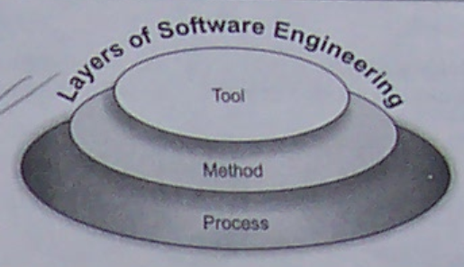
Let’s refresh our mind →
5. Which one of the following is not a software-engineering-layered technology?
a) Process
b) Manufacturing
c) Methods
d) Tools
Ans: Option b is correct
Guideline:
Nilina Bera

Slide 21
Let’s refresh our mind →
6. Based on its applications, software is classified as system software, …………… , business software, …………. , artificial intelligence software, ……….., and personal computer software.
Ans: Real Time Software, engineering and scientific software, web-based software
Guideline: Software, on the basis of its applications, is broadly classified into the following categories:
System software
Application software
Engineering software
Embedded software
Web application
Artificial Intelligence (AI) software
Nilina Bera

Slide 22
Let’s refresh our mind →
7. There are three layers of software engineering, namely, …………. , …………., and …………….
Ans: Process layer, method layer, tool layer
8. ………………. is an individual who is responsible for analysis, design, testing, implementation, and maintenance of software system.
Ans: Software engineer
9. Which of the following is not a part of software?
(a) Programs (b) Hardware (c) Data (d) Documentation
Ans: (b)
Nilina Bera

Slide 23
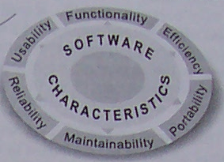
Let’s refresh our mind →
10. Which of the following is NOT a characteristic of software?
Availability (b) Maintainability
(c) Usability (d) Efficiency
Ans: (a)
Nilina Bera

